Slide 1


National Spiritual Day
22 September
Notes:
Welcome. This presentation explores the importance of remembering our heritage in Spiritualism in New Zealand and why we celebrate National Spiritual Day. We will touch on the spiritual communities of the early 1900s, the legal risks of the Witchcraft Act, to the 1924 Spiritualist Church of New Zealand Act and the launch of National Spiritual Day on 22 September 2024.

Slide 2
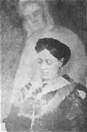
Early Spiritualism in
New Zealand
EARLY 1900s
A strong, supportive Spiritualist community
Daily life guided by an inclusive spiritual philosophy
Focus on personal responsibility and natural law
Notes:
In the early 1900s, New Zealand had a vibrant Spiritualist community. People lived by a philosophy that emphasised personal responsibility, the natural law of cause and effect, and the belief that individuals evolve spiritually over multiple lifetimes under the guidance of a divine source. This philosophy shaped everyday interactions and created a strong sense of community.

Slide 3
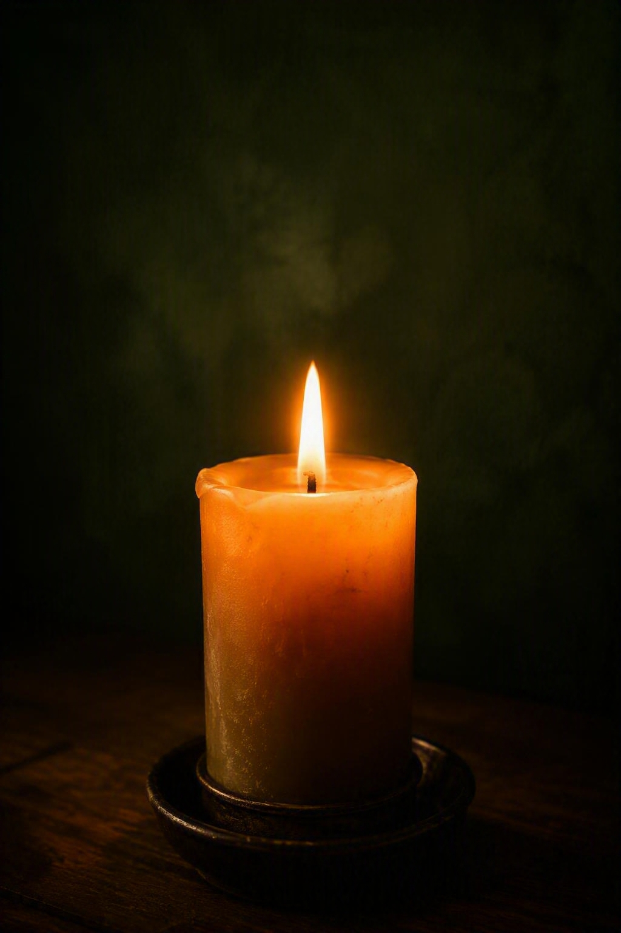
Spiritual Practices & Mediumship
PRACTICE
Communication with spirit beings
Mediumship offered comfort and healing
Angels, guides, and loved ones
Notes:
A defining feature of Spiritualism was communication with the “other side.” Mediums connected with loved ones who had passed, as well as guides and angels. These messages brought comfort, clarity, and healing, especially important in a time marked by hardship and physical labour. Mediumship was seen as a practical, compassionate tool for emotional support.

Slide 4

Legal Challenges & the Witchcraft Act
LEGAL RISK
The English Witchcraft Act 1562 still applied in New Zealand
Penalties included imprisonment and death
Spiritualists feared being misunderstood
Notes:
Despite its positive intentions, Spiritualism faced serious risks. New Zealand operated under the English Witchcraft Act 1562, which imposed harsh penalties, including death, for anyone practising “witchcraft, enchantment, charm, or sorcery.” Spiritualists feared their practices could be misinterpreted, leading to prosecution. This concern sparked a movement to legally protect their community.

Slide 5
The 1924 SCNZ Act
22 SEPTEMBER 1924
Legal recognition
A governing body
Council - 3 yearly
The Spiritualist Church of New Zealand Act gave churches formal legal standing.
The Act established SCNZ as the governing body for member churches.
Representatives met triennially to discuss national issues and elect an executive.
The Act applied only to churches under SCNZ, and membership fluctuated over time.
Notes:
To safeguard their practices, Spiritualists petitioned for formal recognition. Their efforts led to the Spiritualist Church of New Zealand Act in 1924. This established a governing body and gave churches legal standing. Representatives met every three years to discuss national issues and elect an executive committee. The Act applied only to churches under SCNZ, and membership fluctuated over time.

Slide 6
Changing Times & a New Constitution
EVOLUTION
Beyond the pew
2017
SNZ today
Spiritualism expanded beyond church attendance as people expressed spirituality in diverse ways.
A new constitution was written to reflect how spiritual life in New Zealand had changed.
Spiritualism New Zealand now welcomes individuals as well as churches and centres.
SNZ is run by a volunteer Board and has grown through webinars, workshops, and national connections.
Notes:
As society evolved, so did Spiritualism. People began expressing spirituality in diverse ways, not only through church attendance. To reflect this shift, a new constitution was written in 2017. The organisation became Spiritualism New Zealand (SNZ), welcoming individuals as well as churches and centres. SNZ is run by a volunteer Board and has grown through webinars, workshops, and national connections.

Slide 7

The beginnings of
National Spiritual Day
ORIGIN
22 September 2024 marked 100 years of the SCNZ Act
Nationwide celebrations were held
National Spiritual Day continues every year
Notes:
On 22 September 2024, SNZ established National Spiritual Day to mark 100 years of the SCNZ Act. Nationwide celebrations were held, including guest speakers
NSD continues. By celebrating this special day every year, it helps us honour the pioneers who secured legal recognition for Spiritualism and celebrate how we have grown. It’s also an opportunity for organisations and individuals across New Zealand to participate, helping the public learn more about Spiritualism and spiritual living.
Each year SNZ will focus on a different aspect of spirituality. In 2025, we explored Everyday Spirituality and this year, we focused on Building Spiritual Community. In both years, we ran discussion/meditation evenings and provided a variety of content on our website and social media in line with this focus.

Slide 8
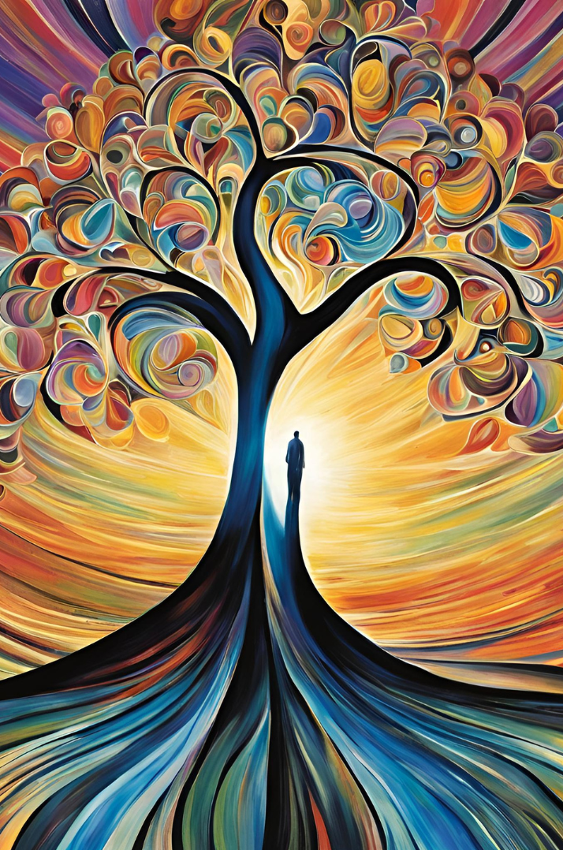
About
National Spiritual Day
ABOUT
Inclusive of all faiths and beliefs
Don’t have to believe in any doctrine
Don’t have to belong to any church or formal organisation
Includes those exploring spirituality on their own
Notes:
NSD is dedicated to honouring the diverse spectrum of spiritual values cherished by individuals throughout our country. While these values may vary from one person to another, they all converge on the fundamental principle of fostering a world grounded in love, compassion, and equality for all beings. NSD is inclusive of everyone. Whether you follow a spiritual practice, belong to a church, or are simply exploring spirituality on your own.

Slide 9

Our Mission
MISSION
Share spiritual knowledge and practices
Guide and support those exploring their spiritual nature
Facilitate exploration of living spiritually
Inspire integration of spiritual practices into daily life
Notes:
On this day and in the days ahead, our mission is clear. We aim to share spiritual knowledge and practices, guide and support those interested in understanding their spiritual nature, and facilitate exploration into what it means to live spiritually. We also seek to inspire people to integrate spiritual practices into their daily routines while nurturing a deeper understanding of their profound significance.

Slide 10
What can you do to celebrate?
22 SEPTEMBER
Individual
Group / Church
Reflect on your personal journey (possibly in a journal)
Create a sacred space in your home and enjoy it
Undertake favourite family rituals
Do something that makes you happy
Sacred text study group
Art exhibition of spiritually inspired art
Screen a thought-provoking film
Group meditation and/or healing
Debate on a relevant topic
Walk in nature
Undertake your favourite spiritual practice – gratitude journal, meditation, breathing, yoga, …
Participate in community service with a local charity or nursing home
Reflection on Building Spiritual Community in an address or talk
Panel discussion
Observe a Healing Moment Ritual or ceremony
Celebratory potluck meal
Notes:
National Spiritual Day provides opportunities to come together and celebrate the spiritual aspects of life, honouring the truth that we are all spiritual beings. It’s a chance to pause, commemorate, and reflect on our connection with Spirit - however we define it. Individuals and groups can celebrate in many ways, from quiet personal reflection to community events. These ideas offer a starting point for creating meaningful experiences.

Slide 11
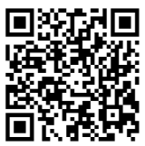
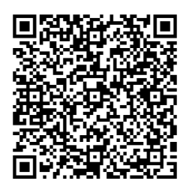
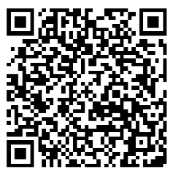
National Spiritual Day . . . 22 September
Website
Facebook
Instagram
Notes:
You can scan any of these QR Codes for more information on the National Spiritual Day website, Facebook or Instagram.

